Slide 1


Diyala university
College of engineering
Department of computer engineering
First stage
Computer since
5- introduction to computer software
Presented By
Abdullah Thaier Abdalsatir Al-obidy

Slide 2
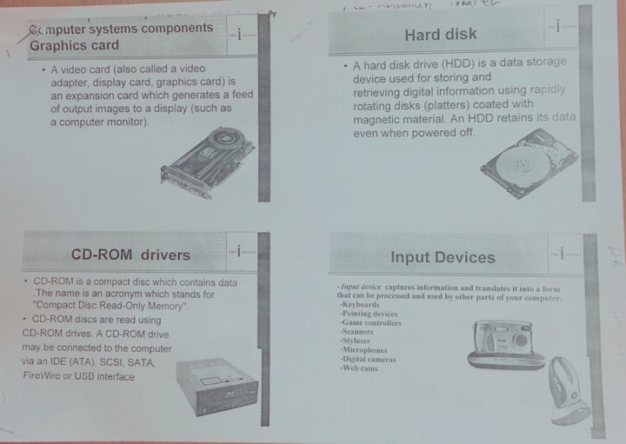
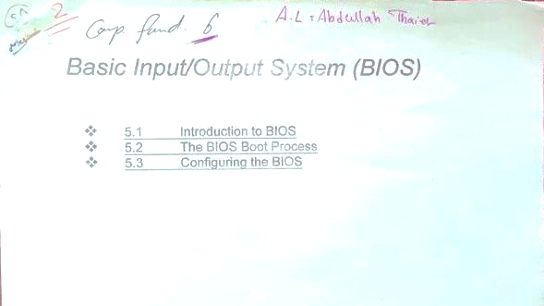
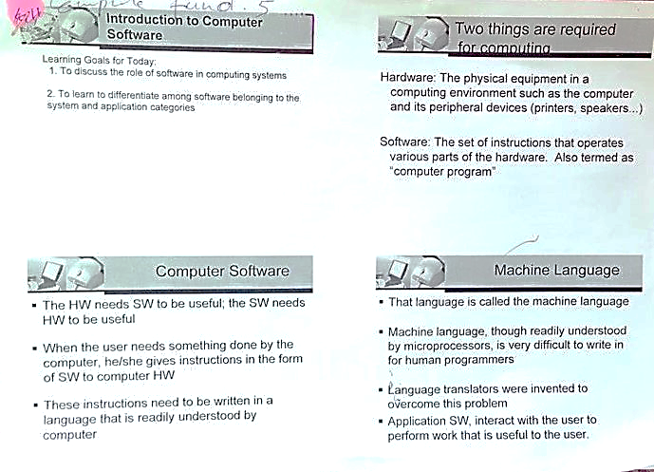
Overview
1. Inside a PC
2. The Motherboard
3. RAM
4. ROM
5. CMOS Memory
6. The CPU
7. Expansion Slots
8. Booting the Computer
the 'brains'
types of memory
the processor

Slide 3
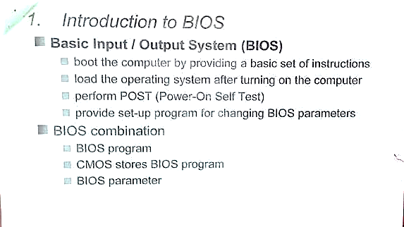
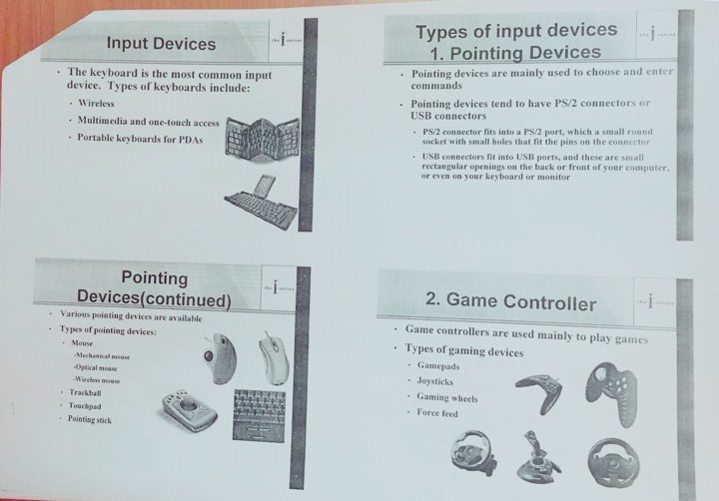
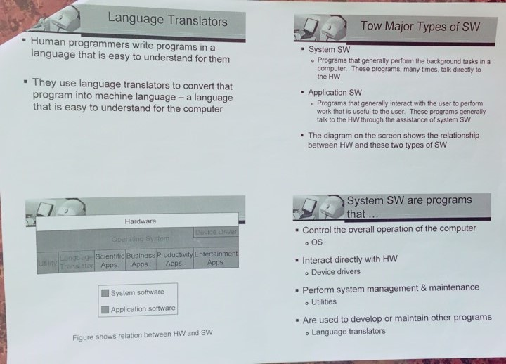
1. Inside a PC
CD-ROM
drive
Power
supply
Hard disk
drive
Mother
board
Floppy
disk drive
Sound/network
cards
Wires and
ribbon cables

Slide 4
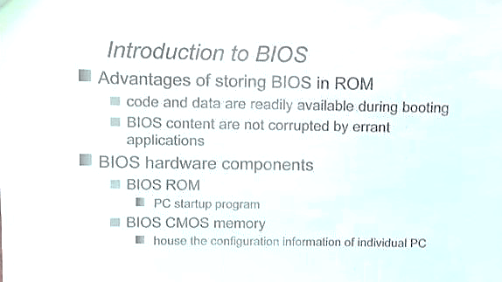
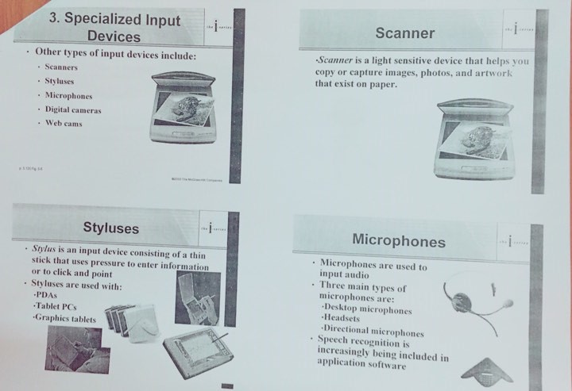
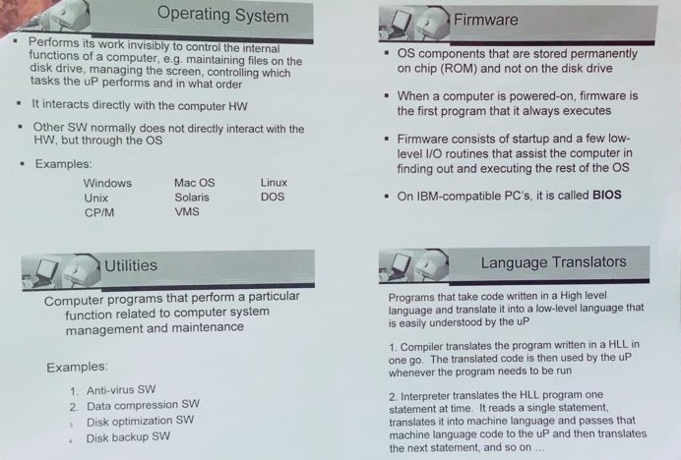

Slide 5
